Slide 1
Sound event detection with neural networks
Moritz Augustin
NI Group Meeting, 13th July 2018

Slide 2
Introduction
Two!Ears EU project
sound event database: NIGENS anechoic earsignals
binaural simulator software: scene mixtures varying noise & sources
system expertise: Ivo
Methods relied on
linear feedforward models: logistic regression
engineered features that contained all temporal information
Extension in progress: nonlinear & temporal models
deep neural networks
recurrent networks: long short-term memory
feedforward (convolutional) neural networks
can be directly applied to features with fine temporal resolution
representations learnt via supervised training
expectation: improved generalization performance over baseline model
Neural Information Processing Group General Sounds Database Earsignals
Trowitzsch, Mohr, Kashef, Obermayer 2017,
IEEE Audio Speech Language Process.
Heiner Spieß, NI project
Changbin Lu, Master thesis
Alessandro Schneider, Bachelor thesis

Slide 3
Data: Isolated Sounds
CURRENTLY EDITED BY HEINER
Class | Waves (count) | min-max (sec) | Total time (min)
Alarm | 49 | 0.9 – 64.6 | 16
Baby | 40 | 1.7 - 123.4 | 18
Crash | 50 | 1.7 – 48.3 | 8
Dog | 45 | 0.2 – 49.4 | 9
Engine | 39 | 4.0 - 132.7 | 35
Scream | 76 | 0.5 – 94.5 | 6
FemaleSpeech | 100 | 1.2 – 5.1 | 5
Fire | 51 | 2.4 – 162.1 | 45
Footsteps | 42 | 3.0 – 33.0 | 19
Knock | 40 | 0.6 – 14.4 | 2
MaleSpeech | 100 | 1.5 – 5.0 | 4
Phone | 40 | 1.0 - 65.0 | 12
Piano | 42 | 2.3 – 196.0 | 15
Total | 714 | 0.2 – 196.0 | 194
General class | 303 | 0.2 – 180.6 | 92
NIGENS: database with human-labeled (on/offsets) stereo recordings (3m head-source distance)
Examples (choose 3 example sounds compatible to mixture below (start with mixture first) and playback them either via vlc/link/embed here s.t. pdf works?)
Add waveform and labels for the 3 examples: should be one labelthrough (e.g. Piano/Caravan.wav) and one with breaks (e.g. Footsteps/*) examples should match to the chosen example mixture on the next slide
Trowitzsch, Taghia, Kashef, Obermayer 2016, Zenodo: https://zenodo.org/record/168042

Slide 4
Data: Scenes
CURRENTLY EDITED BY HEINER
Sound mixtures via binaural simulator
Master source with one (of 714) waves (e.g. TelephoneElectron+6037_36_3)
0-3 distractor sources: random waves from any class (incl. general & master)
Min 30s (repeating short master waves)
Scene: Fixed scene params (#src, azimuth, SNR)
Scene instance: Scene with fixed waves (create the wave of the chosen mixture mathcing the example sounds from the previous slide)
Fig 1 here

Slide 5
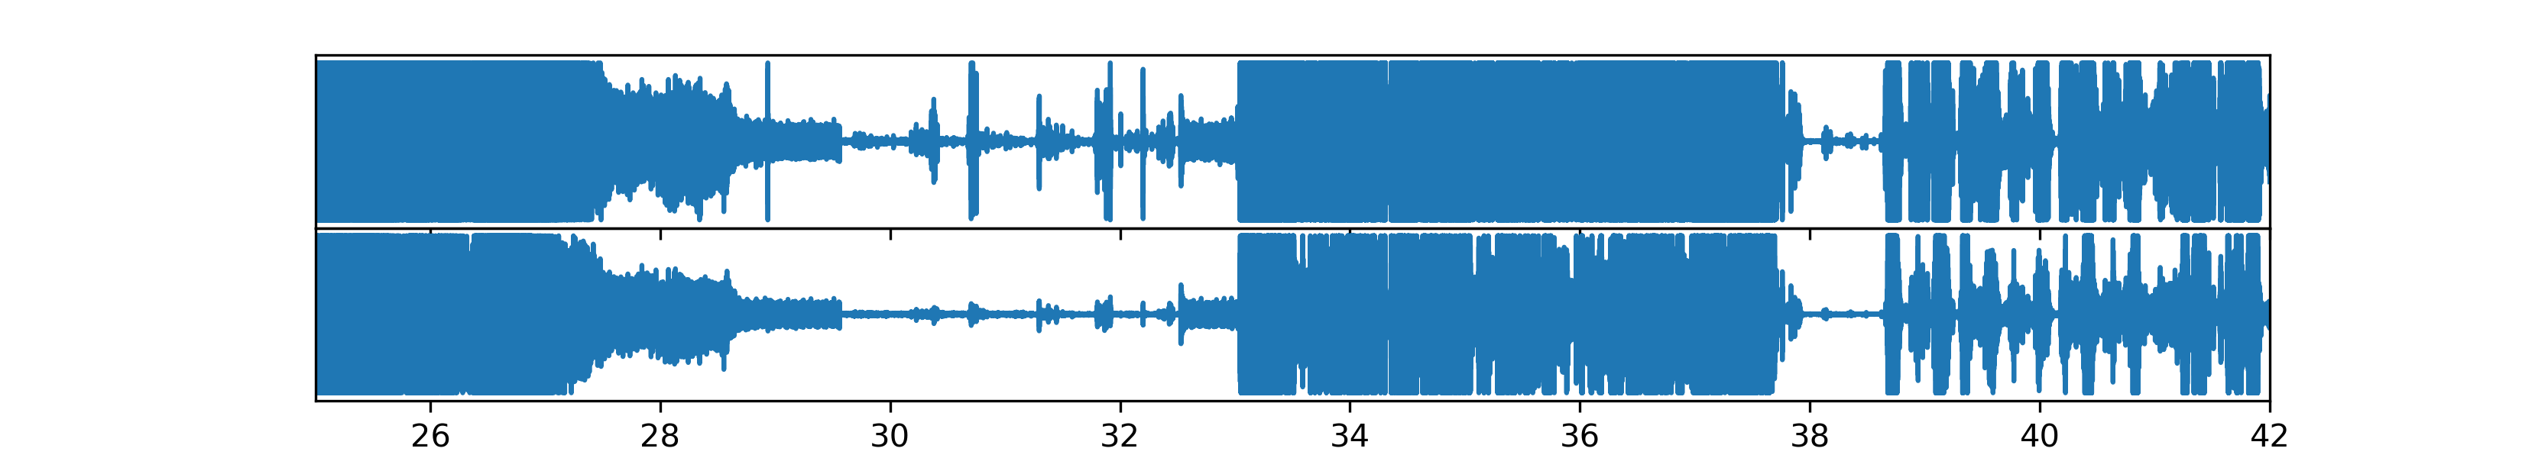
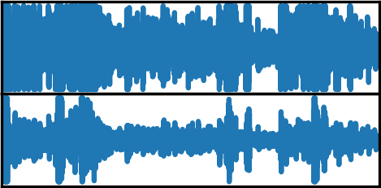
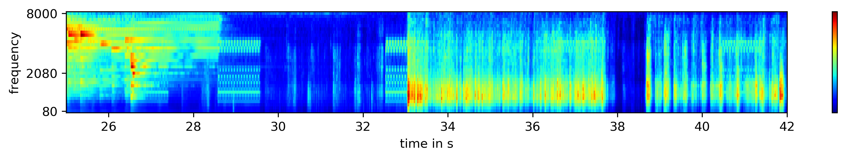
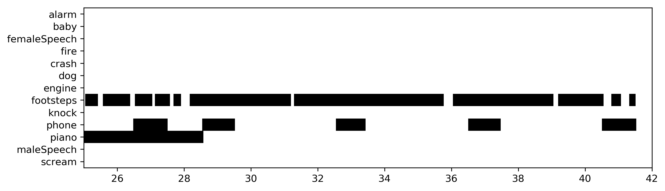
Data: Features
CURRENTLY EDITED BY HEINER

Slide 6
Data: Validation & Testing
CURRENTLY EDITED BY HEINER
Figs 5 & 6 here

Slide 7
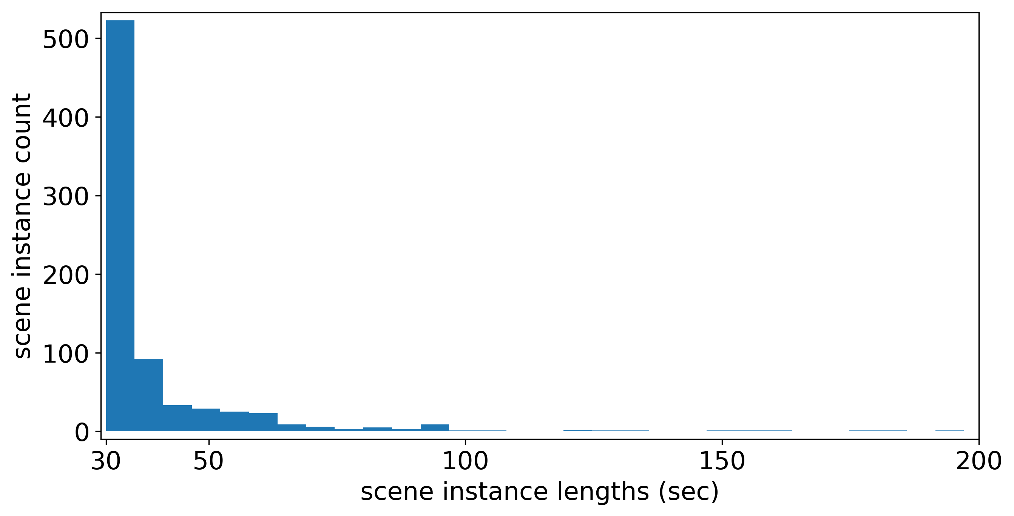
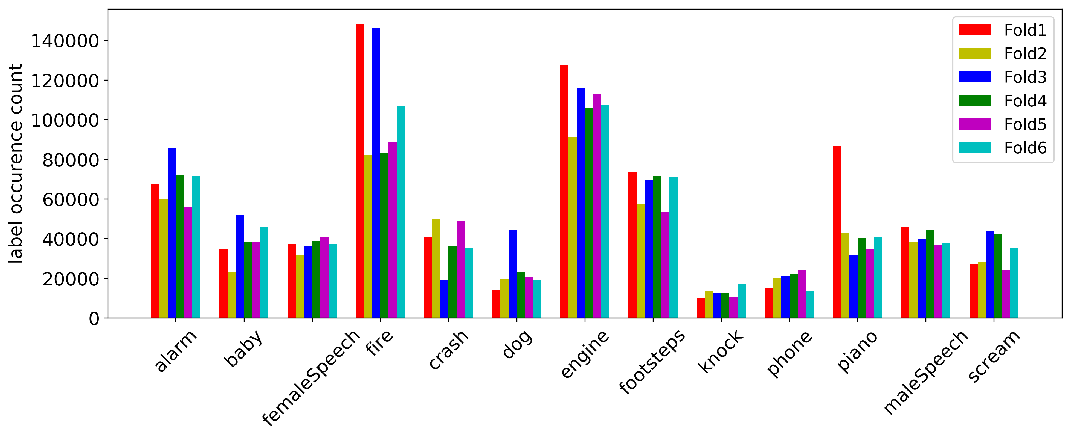
Data: Implementation
CURRENTLY EDITED BY HEINER
Should be used also vom convnet and MLP => comparability
Data standardization

Slide 8
Model 1: Multilayer Perceptron

Slide 9
Model 2: Convolutional neural net

Slide 10
Model 3: Long short-term memory
Motivate verbally: simple RNN cannot learn long term relationships due to vanishing gradient
Inclusive: state transitions, no peepholes (name it)
i.e. Vanilla LSTM
Alternative: GRU

Slide 11
(Recurrent) Regularization
Early stopping
Inseatd of weight decay/L1 we use dropout... Dropout & CuDNN
Give weight matrix based recurrent variational dropout idea

Slide 12
Hyperparameter Optimization
Mention scene subsampling & partial CV here, use fig but not show

Slide 13
Preliminary Results

Slide 14
Issues
Too limited Computational resources (despite Youssef‘s effort / NVIDIA‘s donations / math cluster‘s some GPUs)

Slide 15
Outlook

